Slide 1
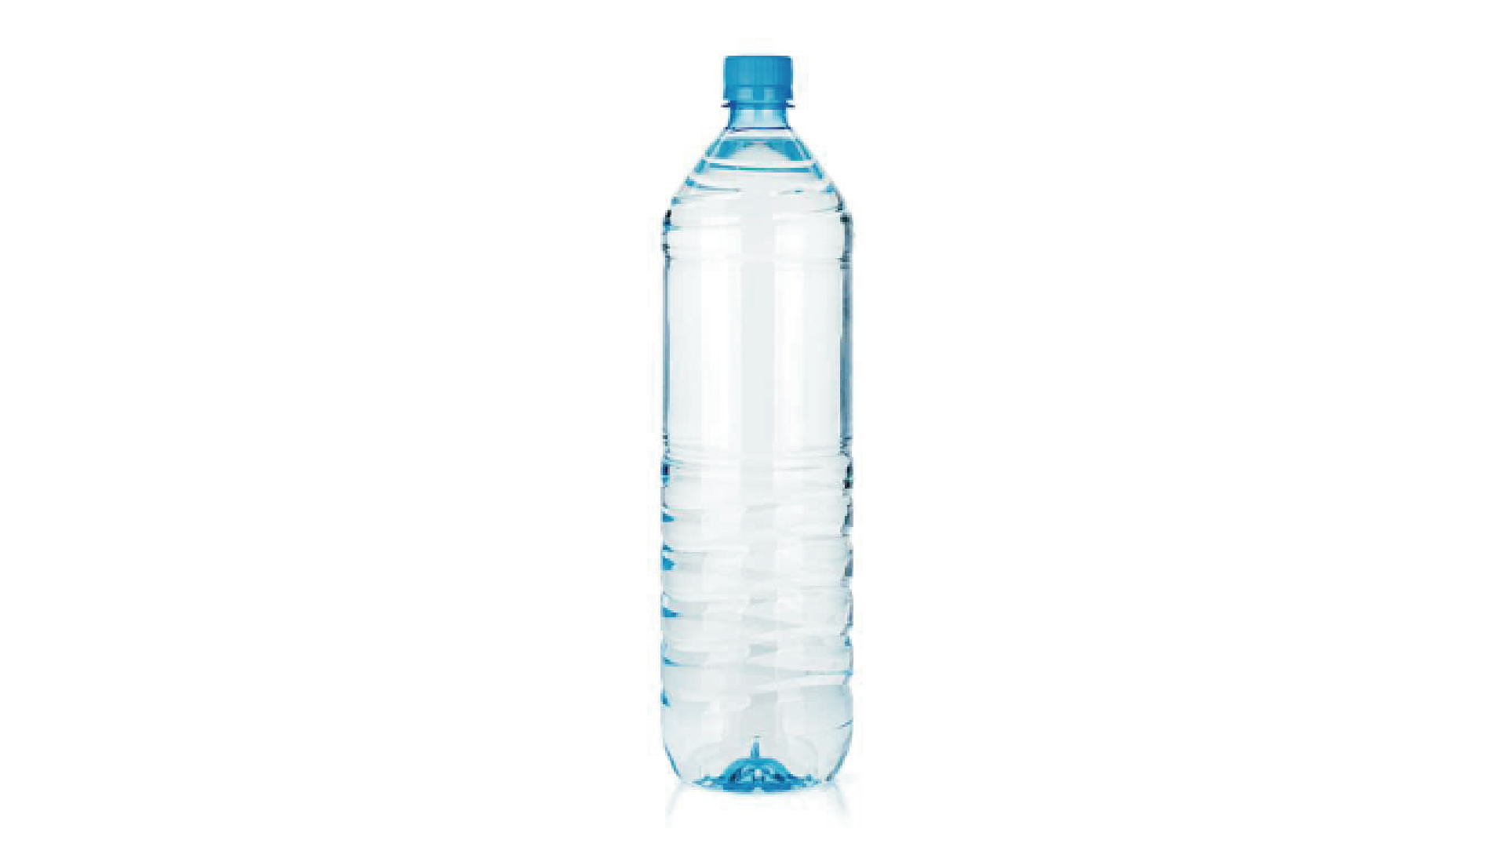
Notes:
How much plastic waste do you produce on a daily base? Not much right? What about in a whole year? Now sum up the waste generated by all of us combined.. What about the 7 billion inhabitants of the planet?

Slide 2
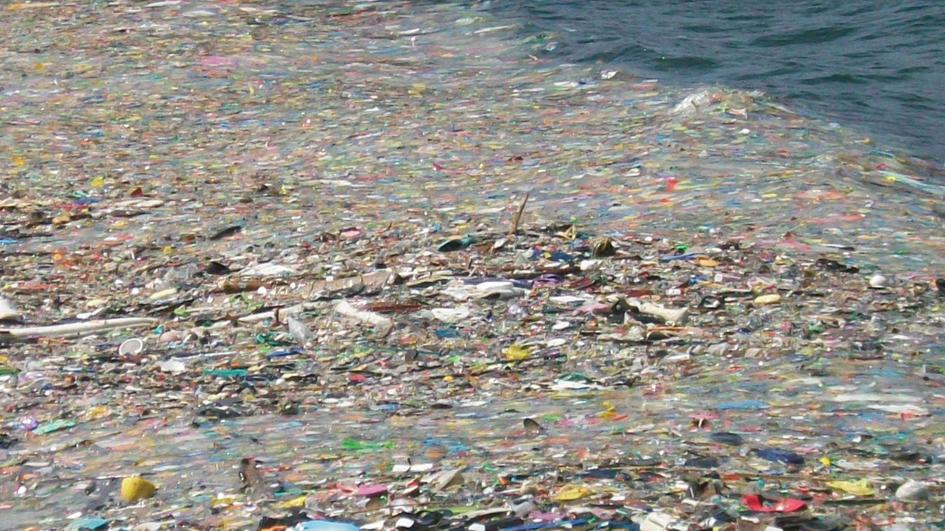
Notes:
It’s estimated that up to 14 million tons of plastic enters the ocean each year!
But that’s not the most pressing issue!
This waste that ends up in the ocean degrades into smaller pieces of plastic under the effects of sun and waves, becoming more and more difficult to catch, and posing a bigger threat to marine life.

Slide 3
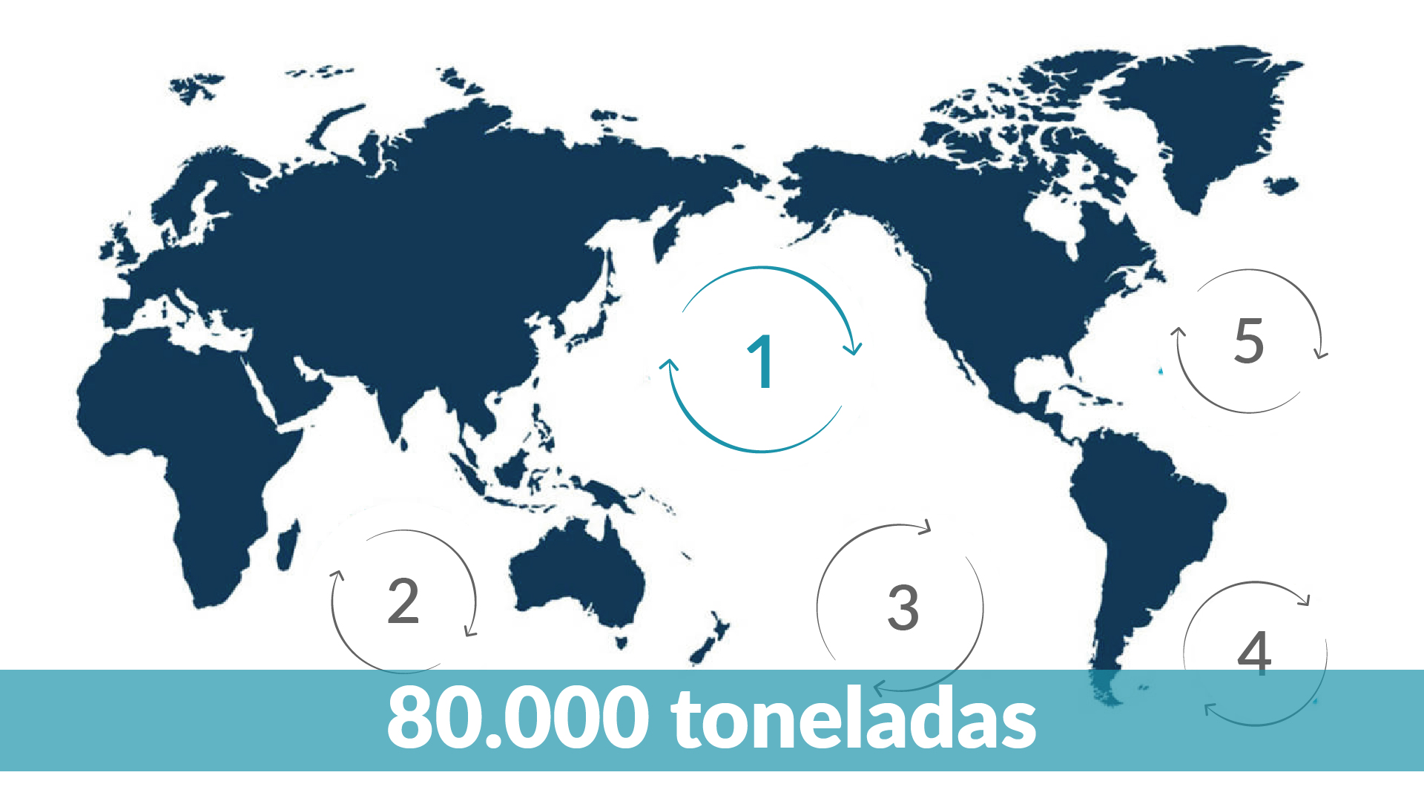
Notes:
The Great Pacific Garbage Patch (GPGP) is the largest of the five offshore plastic accumulation zones in the world’s oceans. It is located halfway between Hawaii and California. It’s 3 times the size of France and has an estimated weight of 80.000 tones.

Slide 4
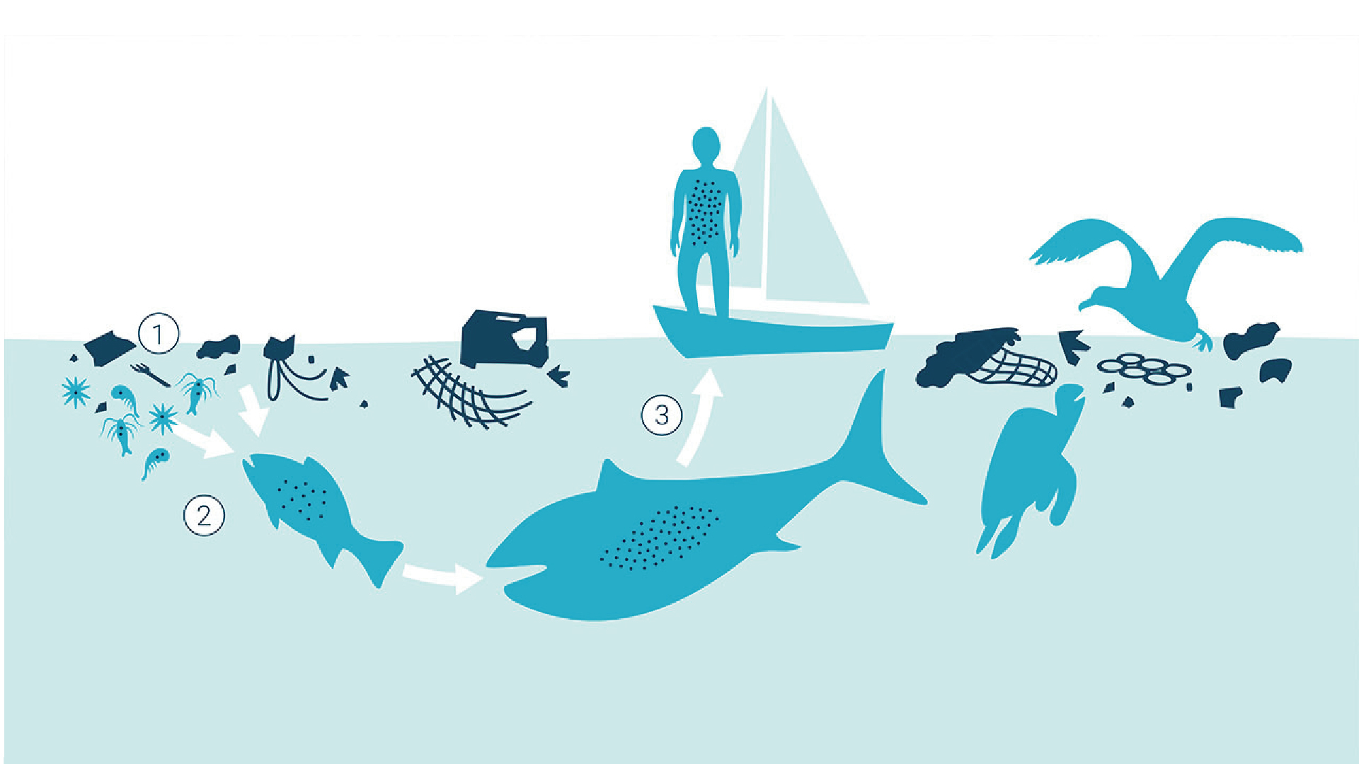
Notes:
It’s estimated that there is 180x more plastic than food at the surface of the great pacific garbage patch. This directly affects marine life, that confuses the debris and consumes it as food, passing the plastic content which is highly pollutant to it’s predator and eventually to human beings, posing not only a huge environmental threat, but also a health and economic threat, especially to coastal cities.

Slide 5
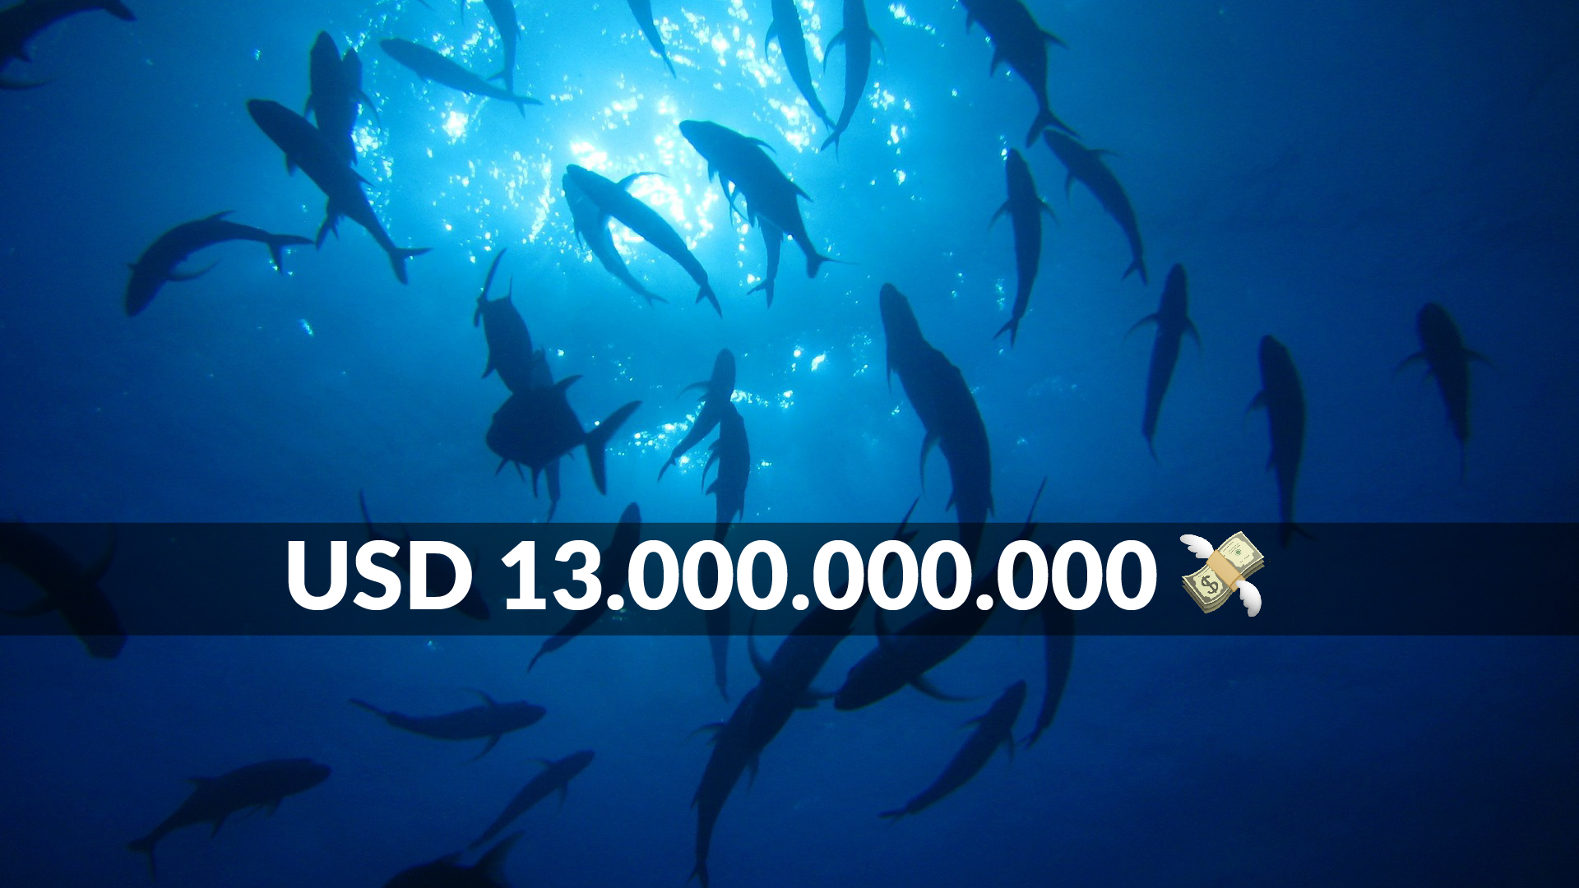
Notes:
The United Nations reported that the approximate environmental damage caused by plastic to marine ecosystems represents 13 billion USD. This figure included the cost of beach cleanups and the financial loss incurred by fisheries.
Unlike many believe, this patch is not an island, so it’s not easily spotted by sight and/or satelital view, nor is easy to find in the ocean. But what if it was??

Slide 6
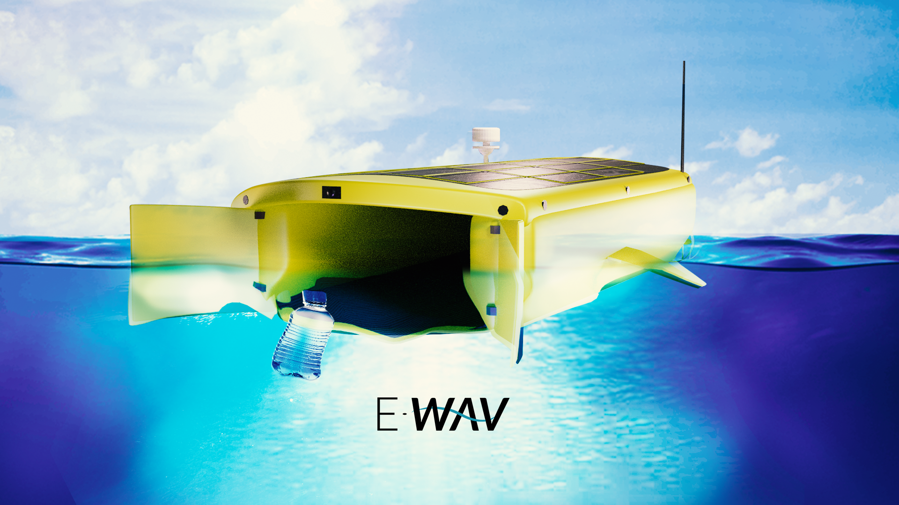
Notes:
Picture this: Several autonomous and automated aquatic drones, working to collect The plastic particles which are later placed on several collection points that will be in charge to hold up the whole set of debris that will form a more manageable patch, to be later easily transported to the coast.

Slide 7
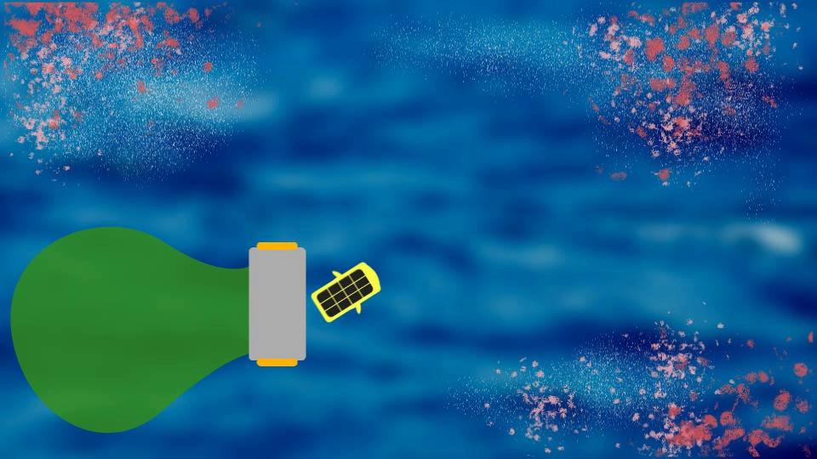
Notes:
Once the collection point is full, it will send a signal that will allow a mission to go collect the waste, or passing commercial ships through tax incentives could drag it closer to the coast. By doing so we would be reducing our carbon foot print.

Slide 8
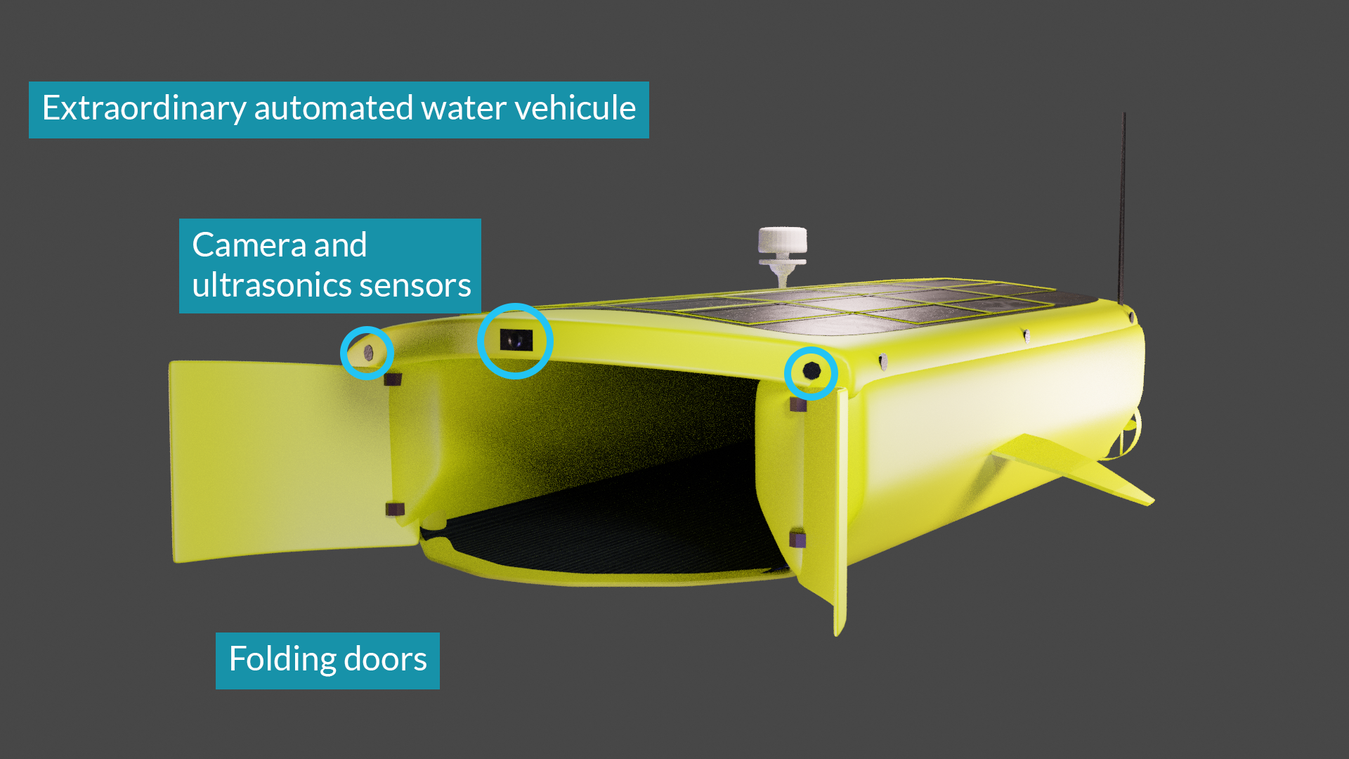
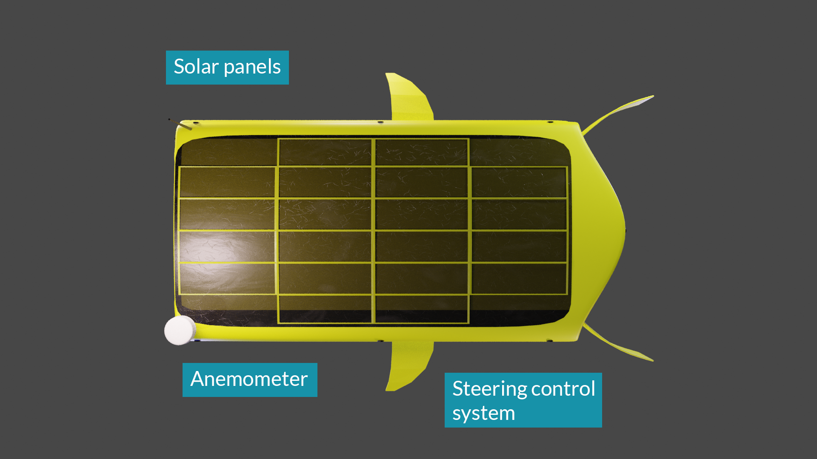
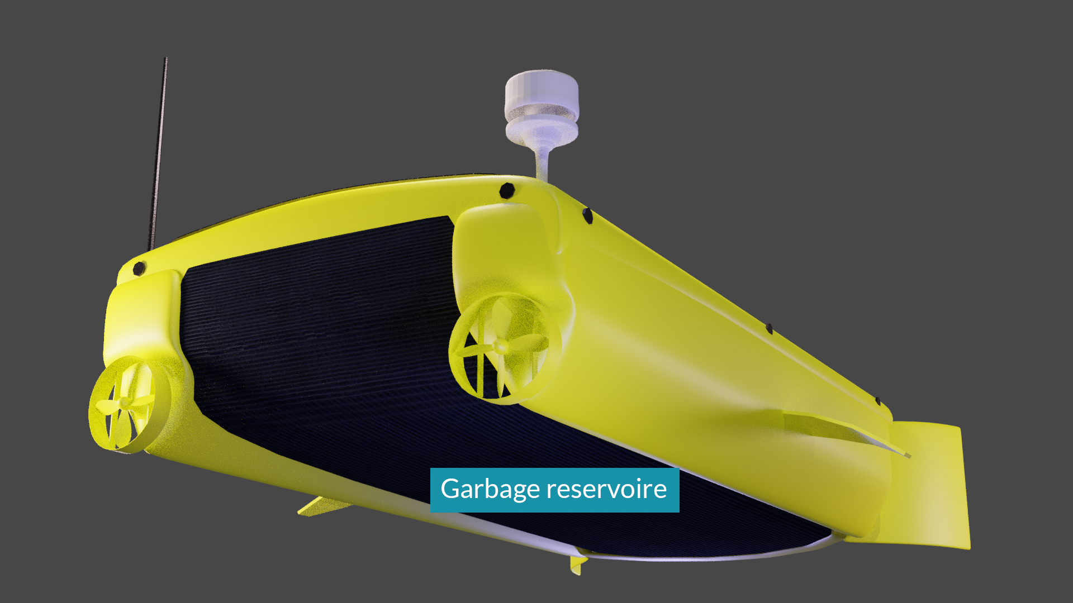
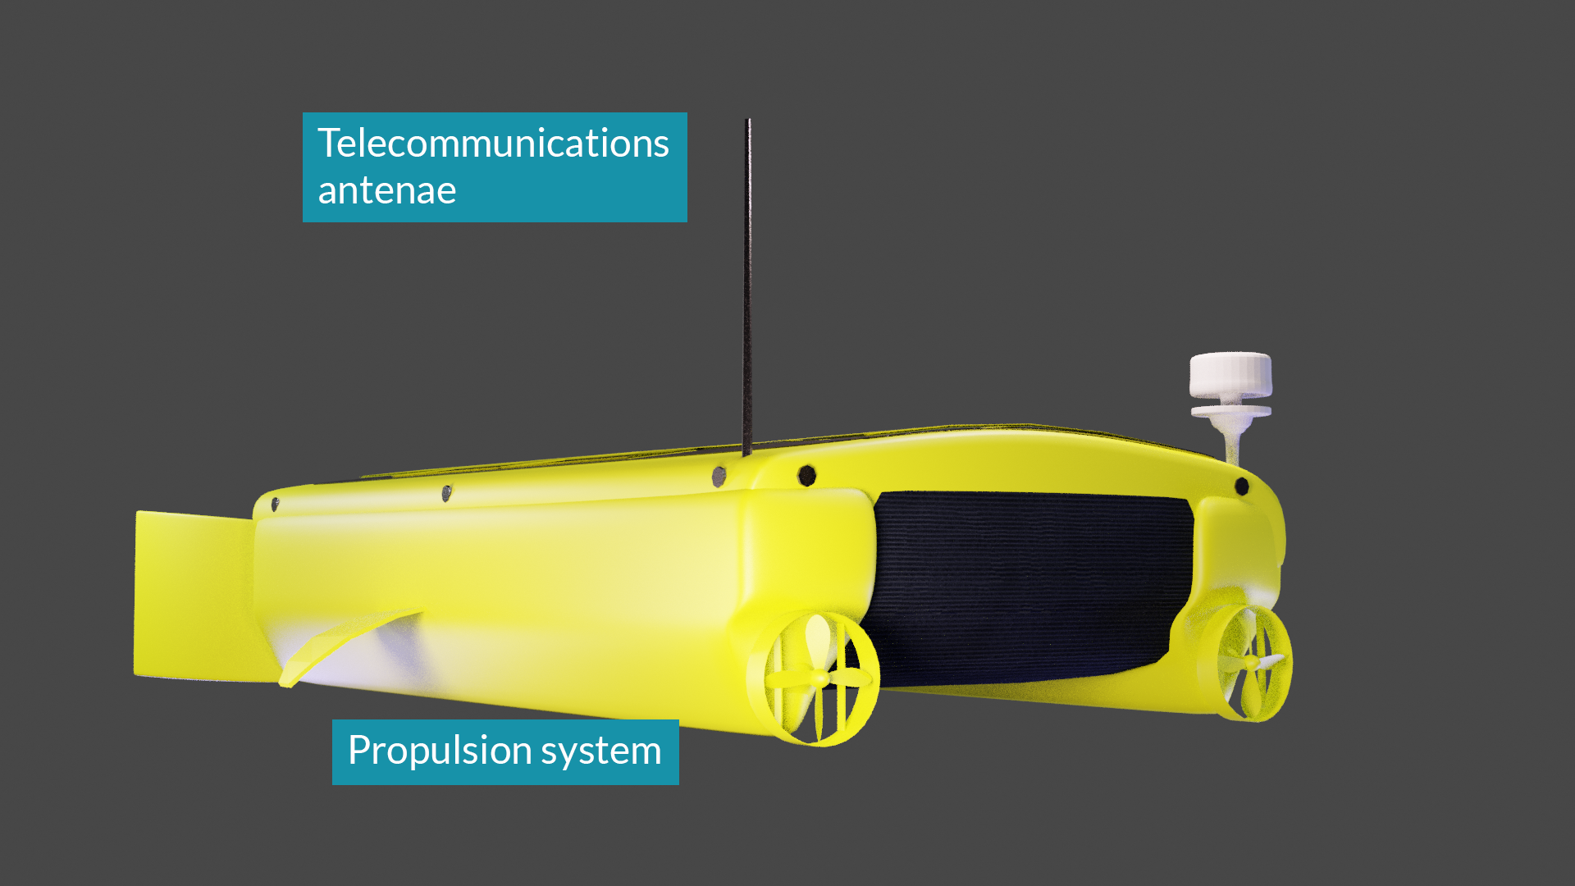
Notes:
The aquatic drones would be fueled by solar energy, have several sensors that will collect data, and use NASA data to determine the best collection route. They will then deposit the collected waste into a central deposit point that will hold the waste plastic until it can be collected.

Slide 9
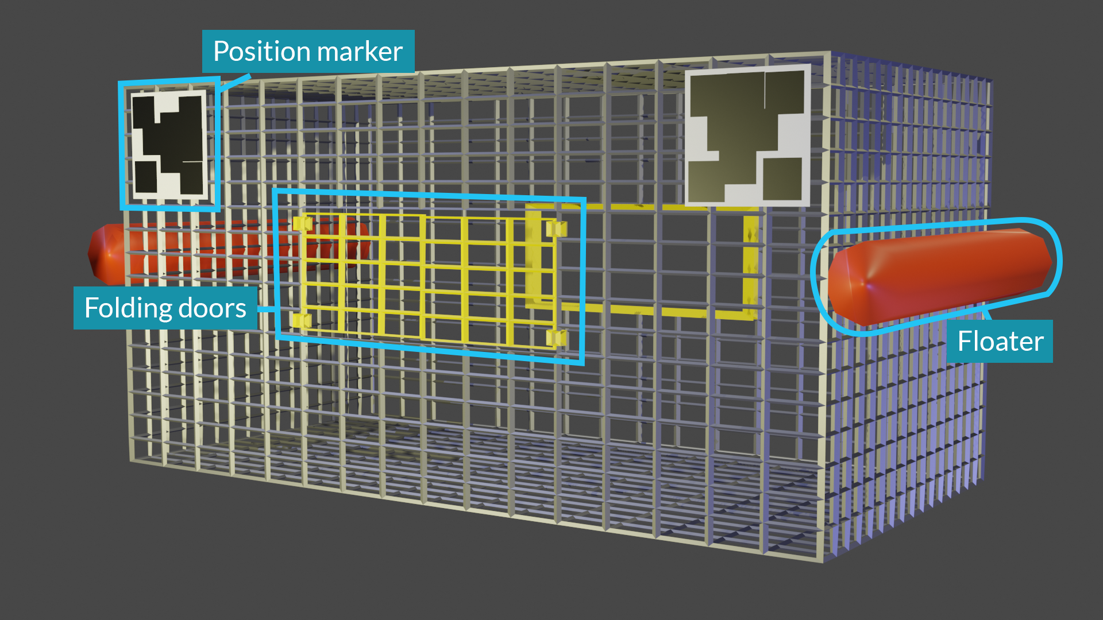
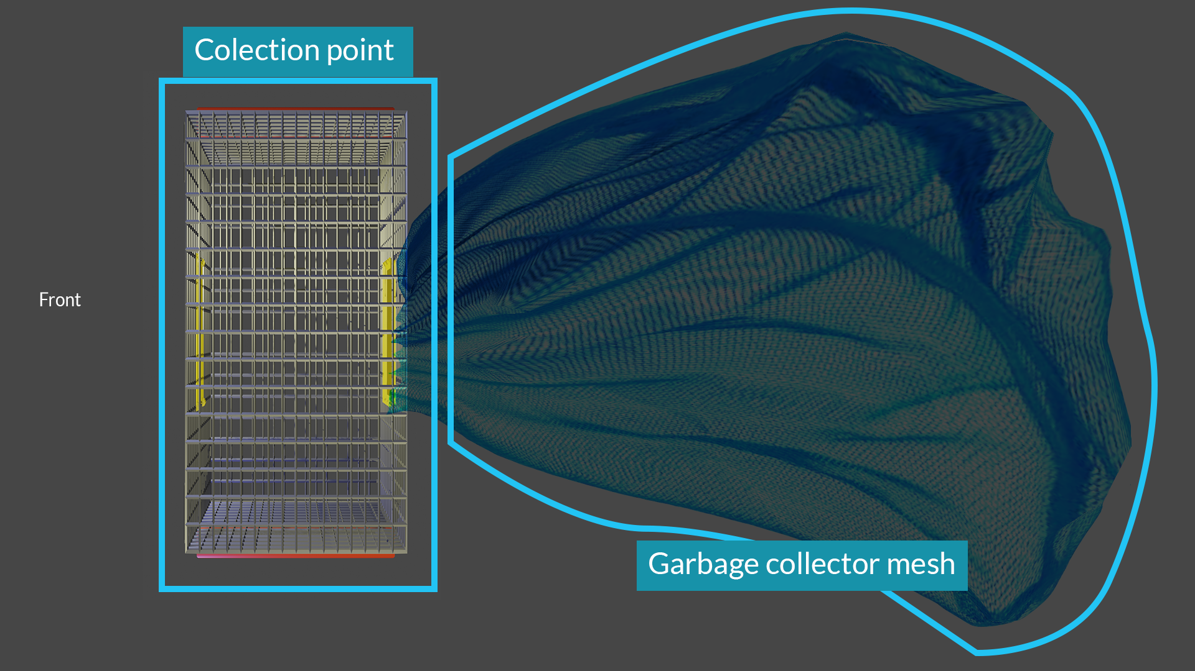
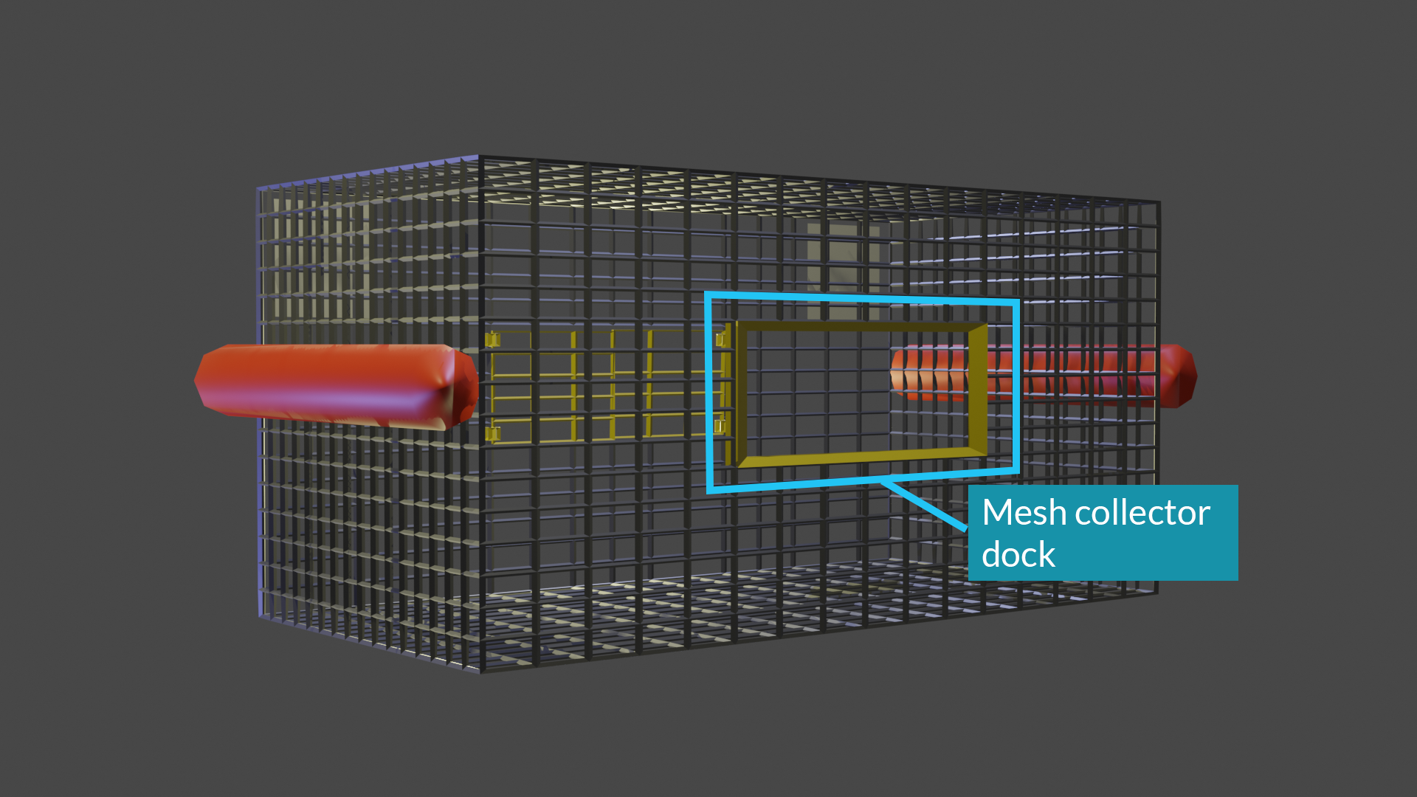

Slide 10
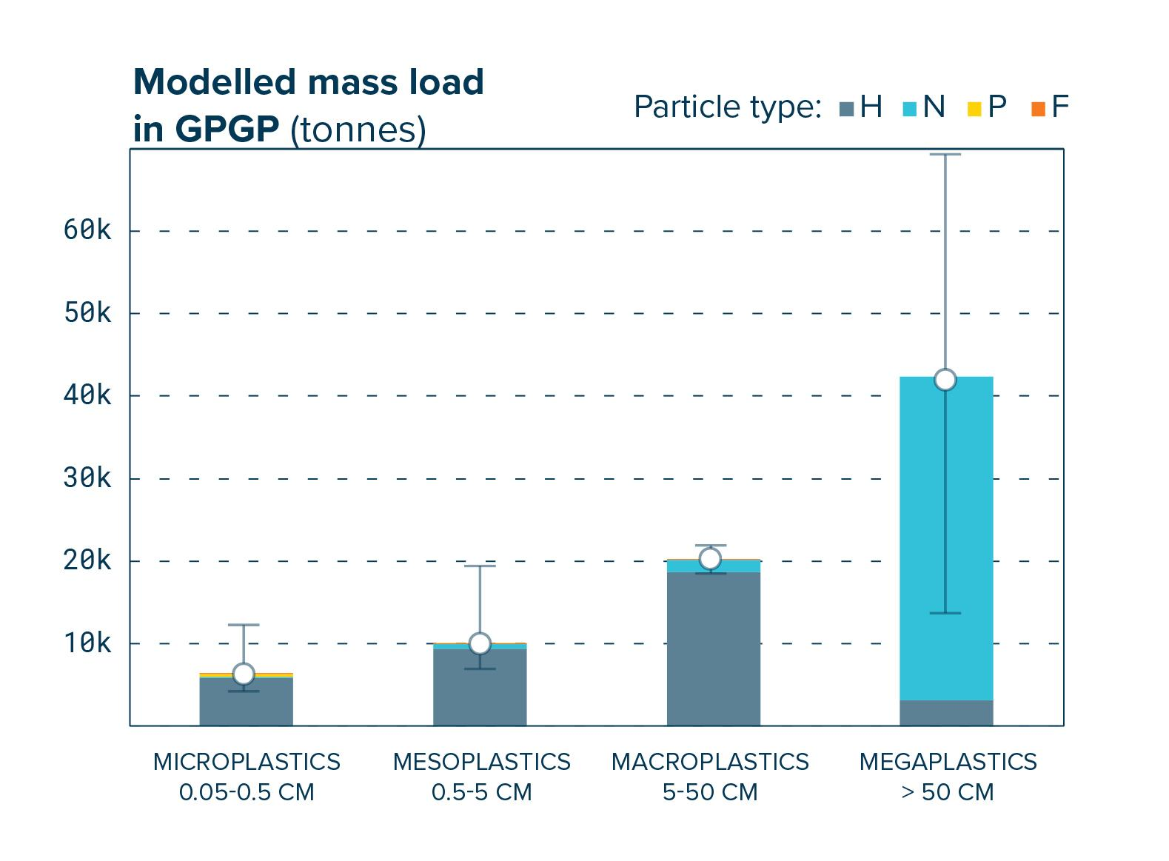
17%
Notes:
There are 4 types of plastic categorized by its size, we want to focus our efforts in Mesoplastics.
Why mesoplastics? It makes up to 17% of the total mass of the patch, which corresponds to 13.600 tons of plastic waste, that could be later turned into microplastic being a lot harder to address the issue. We want to be there before that happens!
A 2015 study estimated that there's between 15 and 51 trillion pieces of microplastic in the world's oceans, weighing up to 261,000 tons. As more and more plastics are discarded into the environment, microplastic concentration in the Great Pacific Garbage Patch will only continue to increase.
Each drone is expected to collect at least 300 kg of mesoplastic a day, considering an initial fleet of 10 drones, by the end of a whole year it will mean a clean-up of 8% of the total mass of mesoplastic in the Great Pacific Garbage Patch. If we are succesful ad doubling the size of the fleet each year, by the end of the 5th year we would be able to collect over 34.000 tones of waste off the water.
The project would be founded by governmental organizations of coastal countries and by selling the waste to be given a second use.

Slide 11
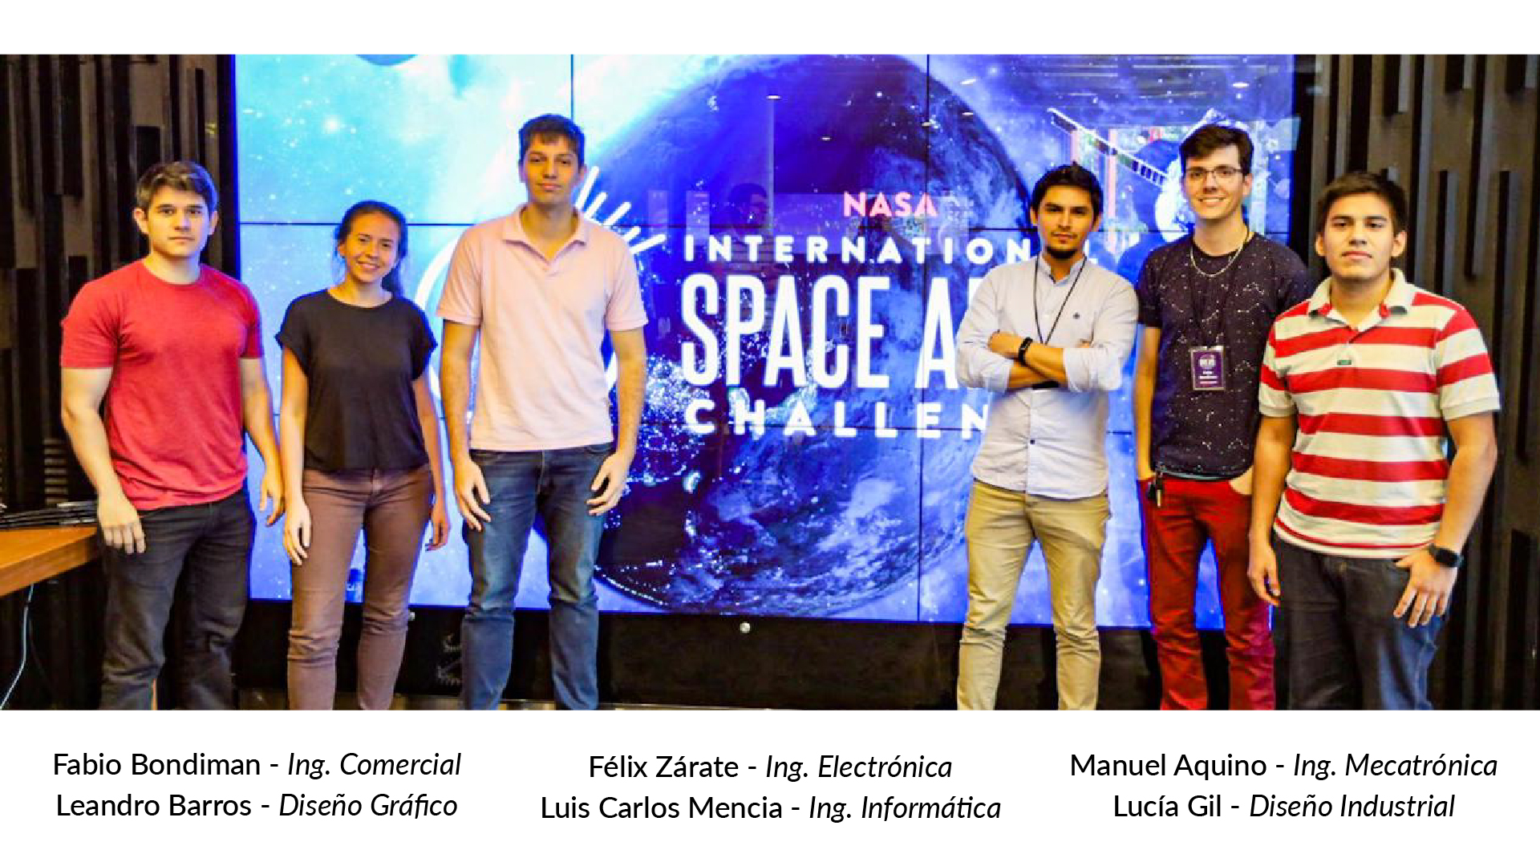
Fabio Bondiman – Commercial Engineering
Leandro Barros – Visual Designer
Félix Zárate – Electronic Engineering
Luis Carlos Mencia –Informatic Engineering
Manuel Aquino – Mechatronic Engineering
Lucía Gil – Industrial Design
Notes:
We’re the ocean rangers, a multidisciplinary team conformed by Felix, Manuel, Leandro, Luis, Lucía and Fabio, and we want to solve the oceans’ plastic pollution problem!

Slide 12

Notes:
And this is E-WAV
An Extraordinary Water Automated Vehicle

